Slide 1









Accessing Google Scholar under Extreme Internet Censorship:
A Legal Avenue
Zhen Lu, Tsinghua University / VMware
Zhenhua Li, Tsinghua University
Jian Yang, Tsinghua University
Tianyin Xu, UCSD
Ennan Zhai, Yale University
Yao Liu, Binghamton University
Christo Wilson, Northeastern University
luzhen02@gmail.com
Dec. 15, 2017
Notes:
good morning evo, my name is zhen lu. I was a graduate student from thu and now work at vmware
my advisor is
and the third author is also here

Slide 2
Outline
1
Background
2
Feasibility Study
3
ScholarCloud System
4
Performance
5
Summary
Notes:
so here is the outline of my pre,
first, lets take a look at the background

Slide 3
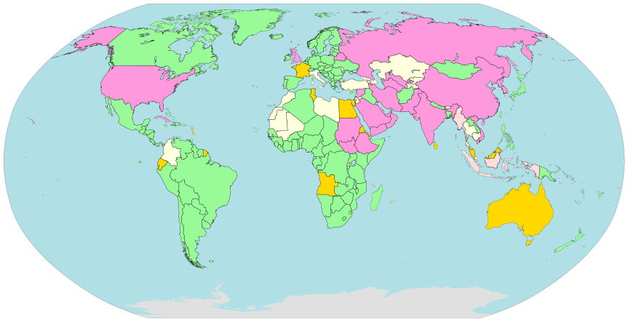

Internet censorship across the world
China, Iran, Russia, Thailand and …
Political
websites are blocked
mostly.
Non-Political
websites may be blocked incidentally!
Notes:
you know, As a matter of fact, the internet censorship is widely exist across the world. mostly, it is used to block some websites for political reasons. But sometimes, some non-political website could also be blocked incidentally, which may have huge impacts on our life. For example, google scholar.

Slide 4


Troubles of scholars
Find a topic -> Google Scholar search -> Read papers
Google Scholar index includes roughly 160 million documents
Notes:
I believe that everyone in this room is familiar with the website
actually it is in the routine of our daily life as scholars, find…
it is so important to us that we cannot image the life without google scholar.

Slide 5
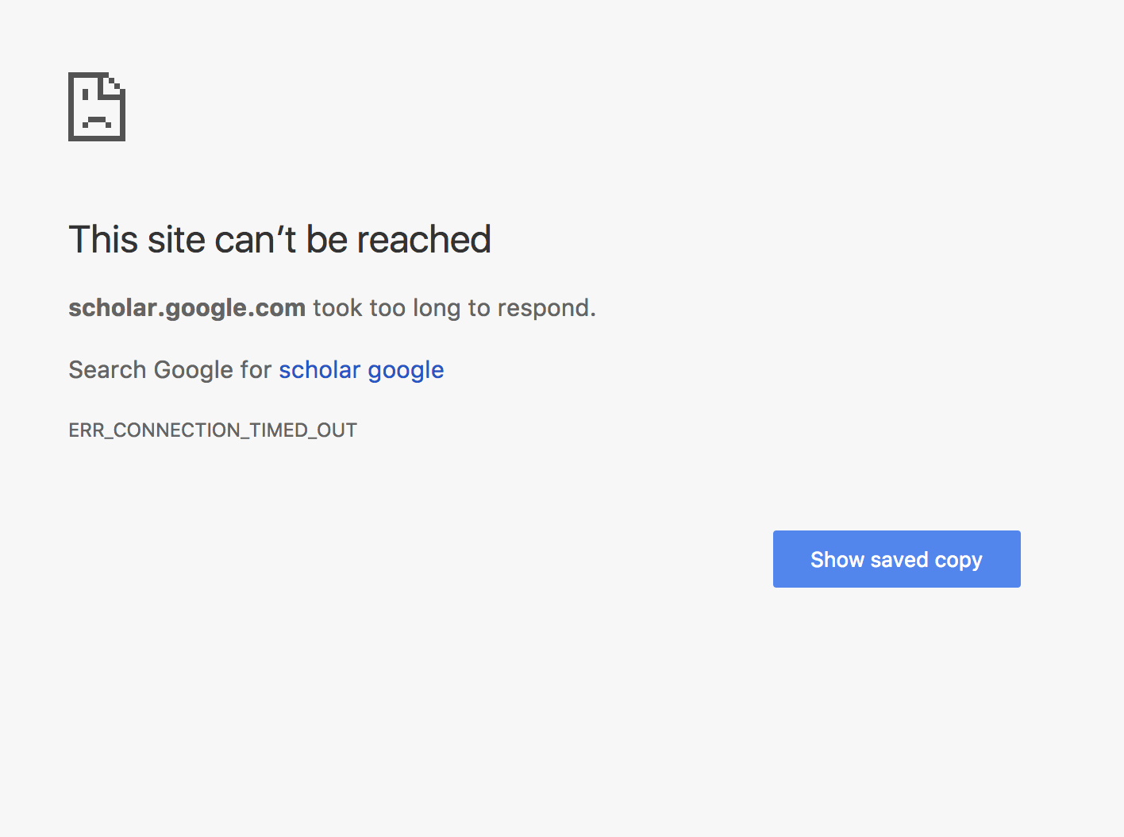



Troubles of scholars
Find a topic -> Google Scholar search -> Read papers
Chinese researchers CANNOT access it.
Notes:
however, if you want to access it in China, probably you will see this, as a result of collateral effect of internet censorship in china.
It is really troublesome to Chinese researchers.

Slide 6





Ways to bypass censorship
All roads lead to Rome!
VPN
Tor
Shadowsocks
Other Proxies
Notes:
therefore, we have to figure out the possible ways to bypass the censorship.
And of course, there are multiple ways to do that.
VPN is a very mature technology and has been widely used. Tor browser, which is famous in this area. SS, a open source project from 2012 by a Chinese programmer intended to bypass the censorship. And a lot of other proxies, which give us so many choices.
And of course, there is another efficient way to solve this problem, you can just take a airplane and go across the network firewall physically, just like me.

Slide 7

Problems of circumvention system
Difficult
to use
Unstable/
not available
Expensive
Illegal
Why not build a system for ourselves?
Notes:
However, this is not the end of the story. Though there are multiple ways to bypass the censorship, problems also exist.
For example, the VPN service is really difficult to setup if you are not a computer science guy.
And frequently, those ways could be unstable or even not available, such as Tor, it can hardly be used in China now.
And if you want a stable and easy to use service, your will probably have to pay, which is not cheap of course.
And except for all of the above, the common issue for those circumvention systems is the illegal use
So naturally, we come up with the idea that, why cannot we build a system to solve all of these problem for accessing google scholar.

Slide 8
2
Feasibility Study
Notes:
And that is also the simple motivation of our project .
So first, in order to have a better understanding about what we are going to do, we do spend some time to investigate

Slide 9
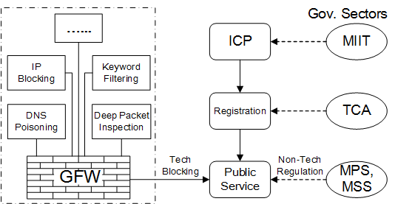


Internet censorship in China
Technical part
Governmental part
Get registered on MIIT website ->
Provide public Internet service legally
Notes:
For example, this is the ecosystem about internet censorship in china, and I believe this is a unique research perspective in our paper.
but I would not spend too much time on the details, the only thing you should know here is that , as you can see in the picture, the left side is the tech part and … right, they are separated, so the the behavior of the Great Firewall of China is not always consistent with the policies of the Chinese government
So, As a conclusion, if you want …, you only need to get registered on MIIT website with necessary info. once the gov approve your application, you can do this legally. So that’s the first step of our feasible study
Telecommunication Administration
Ministry of Industry and Information Technology
Ministry of Public Security
Ministry of State Security
Internet Content Provider

Slide 10
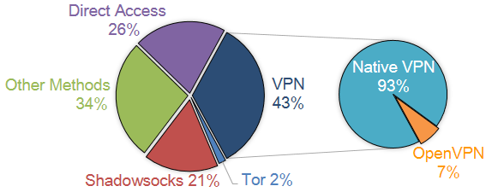
Mainstream Choice
371 faculty members and students from THU
VPN is the most popular way
Shadowsocks also plays an important role
Notes:
then, in order to choose the technique and design our system’s architecture, we tried to have a look at the mainstream technologies.
we make a survey in our tsinghua university. And the result is shown in this picture
As you can see, VPN is … to bypass the censorship, accounting for 43%. And shadowsock, which I mentioned before, also plays…
BTW, you can notice that some people can access the google scholar directly in some time so it is not always be blocked.
After the survey, we chose 4 main technologies to look into and make comparison.

Slide 11
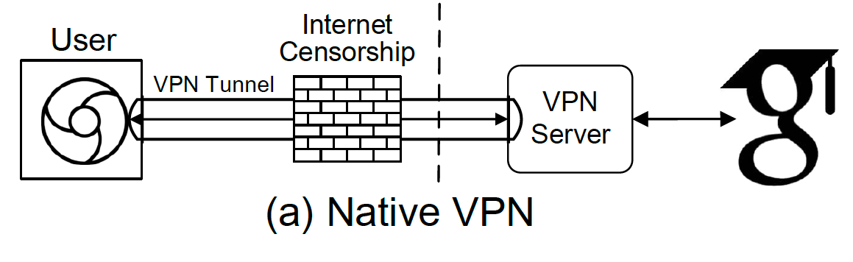
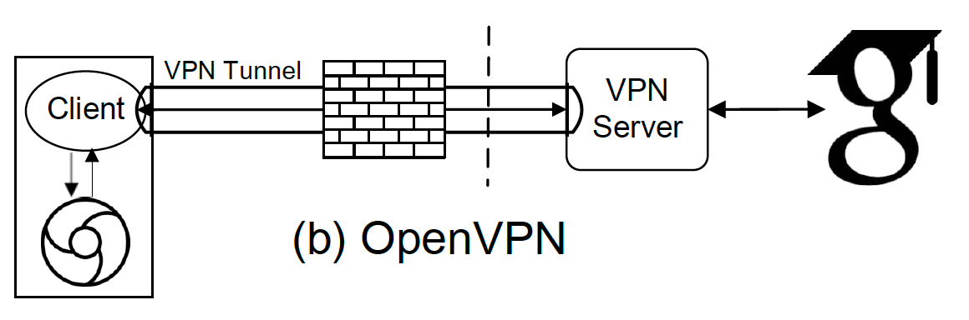
Comparison
VPN
√ Stable
× Exposed to GFW (DPI)
openVPN
√ Secure
× Bad Usability
Notes:
first, VPN is a very mature tech. it will establish a VPN tunnel between the user and VPN server and it is very stable, but in contrast, it is not robust to internet censorship because it’s specific encryption way can be easily exposed to deep packet inspection of GFW .
While openVPN could solve this problem because it can use self defined encryption way to setup VPN tunnel, but it is really difficult to use, not only it has a client but also it is not easy to setup.

Slide 12
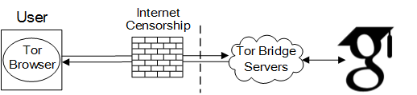
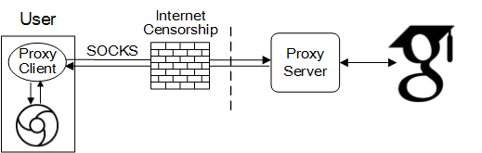
Comparison
Tor
× Exposed to GFW (DPI)
√ Automatic Configuration
Shadowsocks
√ Easy to setup
√ Traffic split
Notes:
Then about the the Tor, it allows users to connect the tor bridge using specific encryption way, which can be also easily exposed to DPI. but the biggest advantage of Tor is that is has automatic configuration, which is very friendly to users.
Last but not least, the shadowsocks tool can bypass the censorship using socks connection. it is very easy to setup and use though it also has an extra client. And it also has a unique feature which is traffic split. it means your traffic do not have to go through the proxy all the time like VPN and tor, it will only forward the traffic to the proxy server when necessary

Slide 13
3
ScholarCloud System
Notes:
So, after look at all of these systems, here comes our self-build system called sc

Slide 14
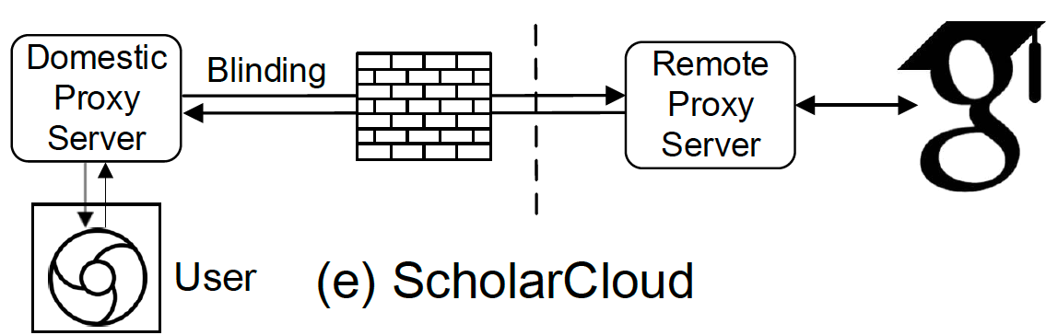
Combine advantages together
Internet
Censorship
√ Stable
√ Secure
√ Auto-config
√ Traffic split
Notes:
We build the system aiming to combine… and this is the architecture of our system, actually, it is based on the architecture of SS so naturally it can support traffic split. And as you can see, the only difference between them is that we separate the proxy client to a independent proxy server in order to support auto-config. what’s more, we blind the connection way so that it will be stable and robust to the censorship. Which I’ll explain later

Slide 15
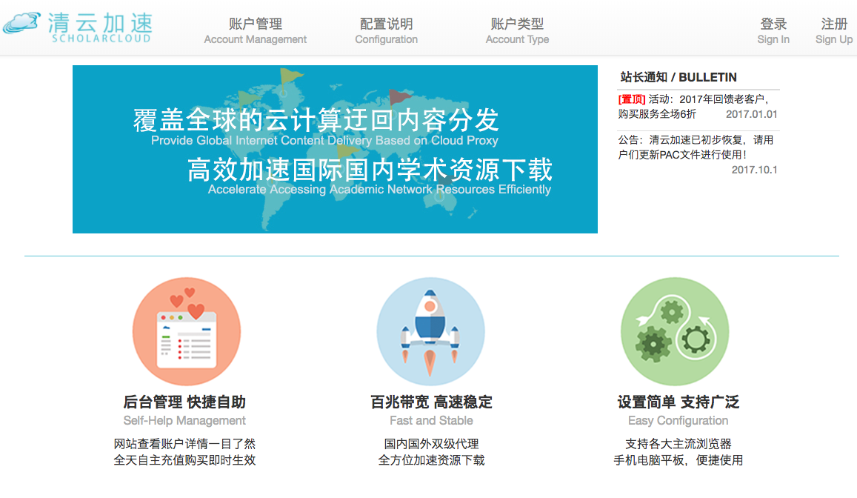
Combine advantages together
Internet
Censorship
√ Stable
√ Secure
√ Auto-config
√ Traffic split
http://scholar.thucloud.com
Notes:
And this is the website portal of our scholar cloud system, here is the URL if you want to take a look

Slide 16

Combine advantages together
Internet
Censorship
√ Stable
√ Secure
√ Auto-config
√ Traffic split
Launched in Jan. 2016
2000+ users/ 700+ daily active users
2.2 USD operation cost daily
http://scholar.thucloud.com
Notes:
it is a project launched in 2016 January. To the end of the paper submitted, it has over 2000 users with 700 daily active users and the daily cost is merely 2.2 US dollars.

Slide 17

Key points
Split-proxy and auto-config
http://pac.scholar.thucloud.com/df70d12a-f586-11e5-980a-08002705856d.pac
Proxy Automatic Configuration file (PAC)
Web proxy
Internet
Censorship
Notes:
So after the introduction of our system, here are some key points that I would like to share with you. The first one is the split-proxy architecture and auto-configuration.
As you can see in this picture, we have two proxies, one is located in China and the other is outside of China. So we don’t need any client in the user part, the only thing you need to do is to past the URL of the pac file to your machine, and then it will automatically configure the web proxy. After that, when the user surfs the Internet, it will automatically use our system to bypass the censorship in certain conditions.

Slide 18
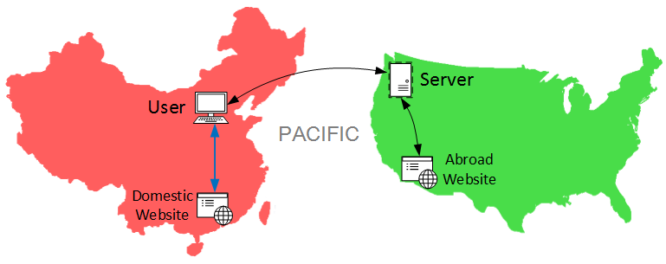
Key points
Split-proxy and auto-config
http://pac.scholar.thucloud.com/df70d12a-f586-11e5-980a-08002705856d.pac
Proxy Automatic Configuration file (PAC)
Web proxy
Notes:
And due to the benefit of the PAC file, we can also split our user’s network traffic. It means, you will only connect to the remote server when necessary, and when you are trying to access a domestic website, you will access it directly without the remote proxy server.

Slide 19
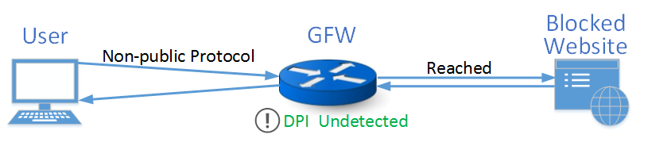
Key points
Message blinding
Public well-known encryption schemes suffer from DPI.
(Liang Wang, CCS 2015)
Internet
Censorship
Notes:
The second thing that I’d like to mention is the message blinding. As I mentioned in VPN and Tor part, public and specific encryption ways … as liang wang said in
However, in our experiment, we find that only if we use a self defined non-public encryption method, even it’s pretty simple, the censorship could not detect us. So we call this message blinding. We make our encryption ways invisible to everyone. and then DPI will not detect us.

Slide 20
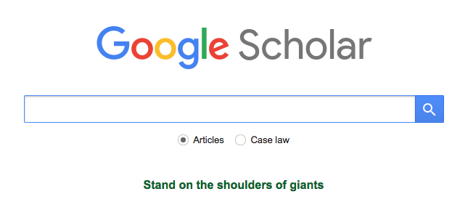
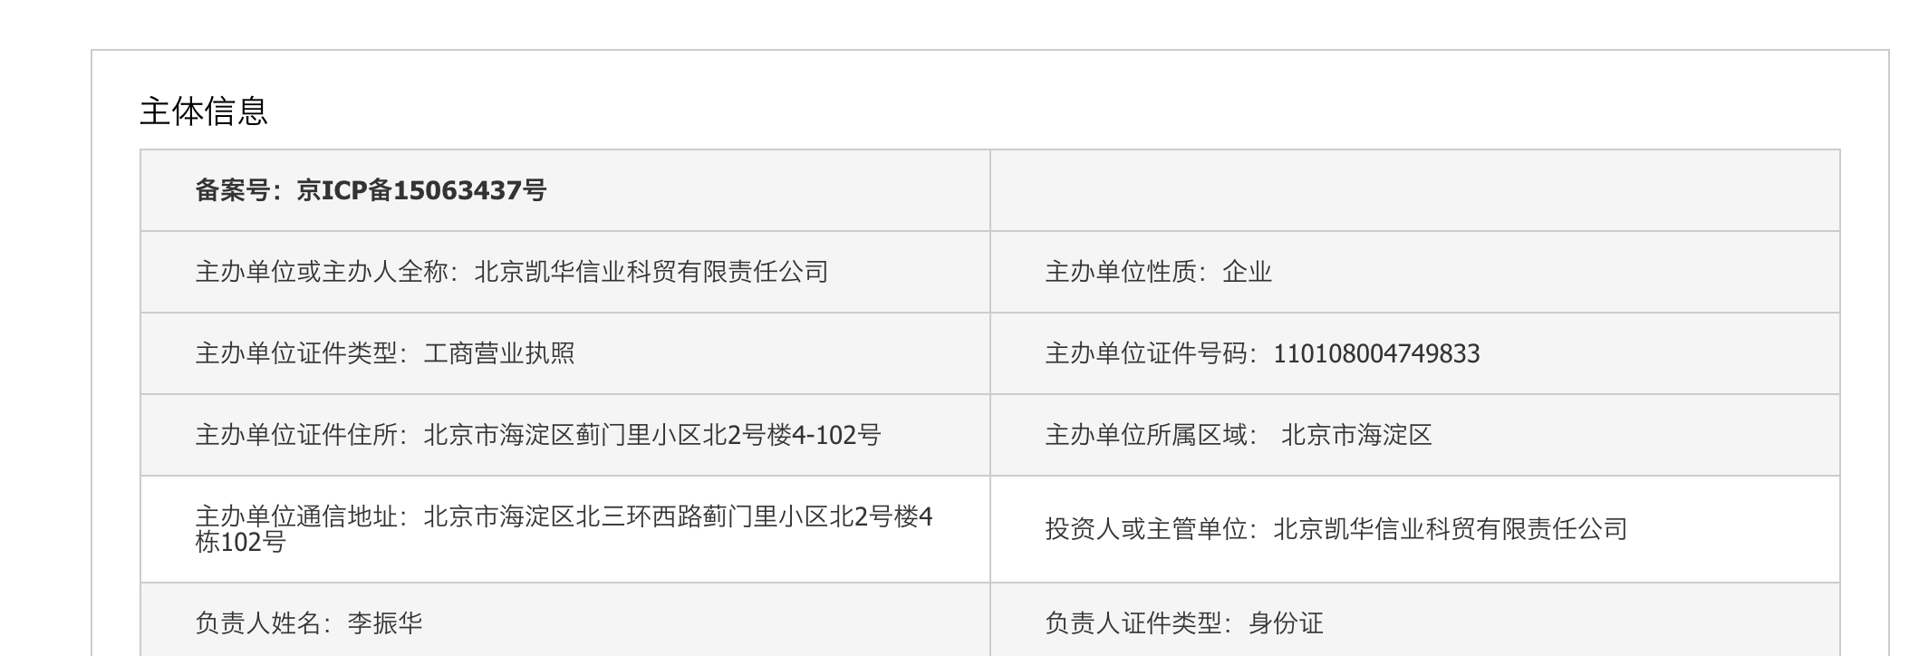


Key points
Service legalization
ICP Reg. #15063437 in China
Internet
Censorship
Notes:
And the last one is the service legalization. we registered it on the MIIT website and got a ICP Registration number, so that we can provide our internet service legally and our users, so Chinese scholars can finally access the google scholar.

Slide 21
4
Performance
Notes:
so after the introduction of our system, I’d like to share the performance result of our measurement. In this part, we put all of the mentioned systems together in order to find more interesting result.

Slide 22
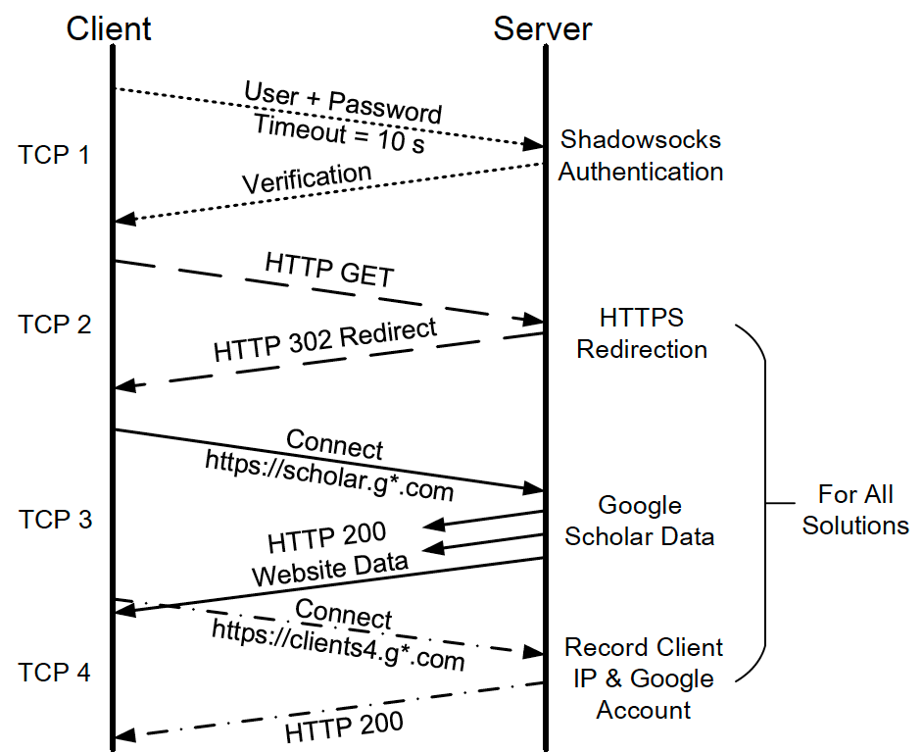

Network experience
1 TCP Stream
S.S. only. 10s timeout.
Main stream
First-time* access cost
Notes:
the first part of performance is the network experience. In this part, we dig into the TCP stream level to see what really happens here. As you can see, there will be four TCP streams when you try to access google scholar.
The first one is shadowsocks authentication steam at the beginning. It only happens in SS and it will happen every time when the connection timeout is larger than 10 seconds, it really has a considerable effect to the performance of SS which you will see later.
The TCP stream 2 is about HTTP redirection while the main traffic stream is TCP stream 3.
And at last you can also notice that there is a TCP stream 4 about the first-time access of google scholar, in which google will record some of your information, it will have some effects on the result of the next page

Slide 23
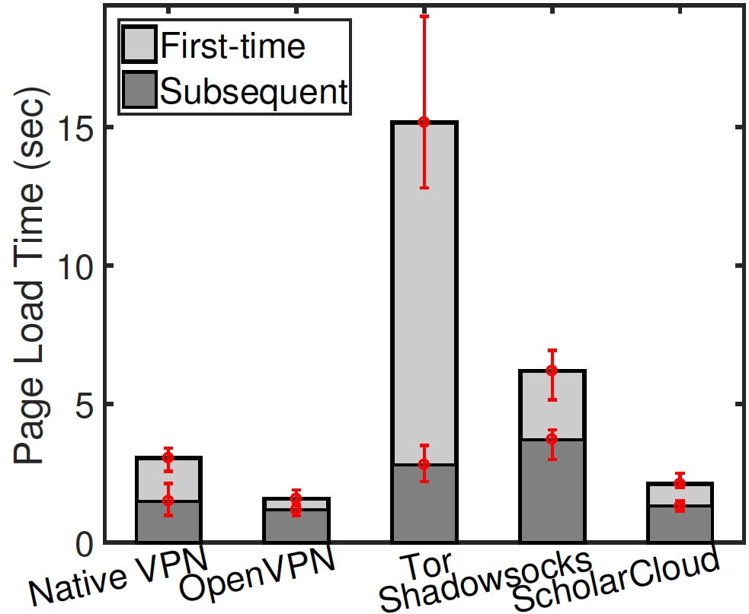
Network experience
2 Page load time
Worst first-time latency 15s —— Tor
Wost subsequent latency 4.5s —— S.S.
First time access suffers great latency:
DNS resolution / Web cache / Google record*
Notes:
After we understand the access process, we would like to take a look at some specific metrics. The first one is page load time, which the users are most concerned about.
So here in this picture, we can obviously see that the first time access latency is much longer than the subsequent access. That’s mainly because you will spend some time on DNS resolution and you do not have any web cache to rely on, also google’s record action is a main reason for this, as I mentioned in the previous page.
What’s more, you can see that the worst first-time latency is Tor, it means it will take 15 seconds for Tor to open google scholar, which is unbearable. And the worst subsequent latency is 4.5 seconds for shadowsocks.
While the others are almost the same

Slide 24
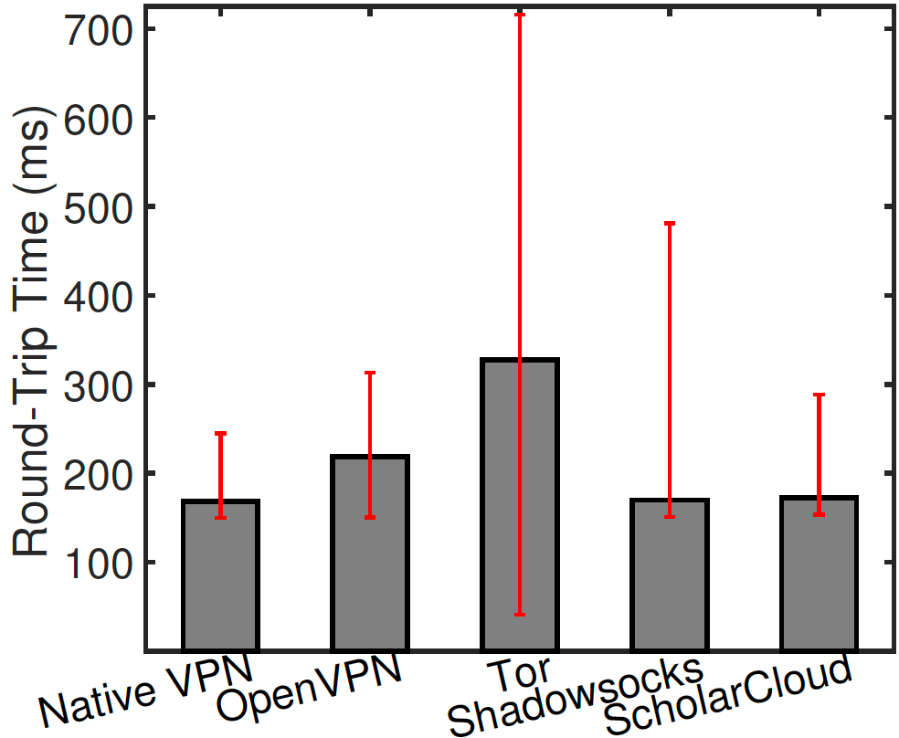
Network experience
3 Round-Trip Time
Tor has the largest average RTT
Tor is also the most unstable one
Shadowsocks shows the same average TTL but much larger max TTL*
Authentication
Notes:
The next metric is round-trip time.
You can see that Tor has the…. it explains why tor has the worst page load time in some degree.
Except for that, you can also find that though shadowsocks shows the same average RTT as scholarcloud but its max value is much larger. which is the result of the authentication TCP stream.

Slide 25
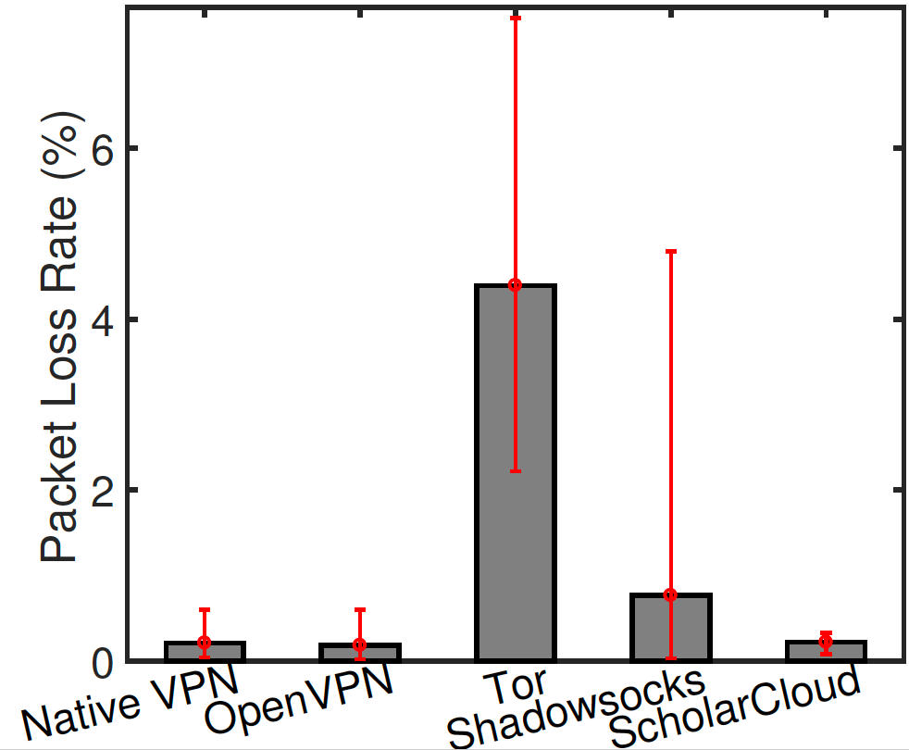
Network experience
4 Packet Lost Rate
Tor suffers from 4.4% PLR
Compared with normal website access (Amazon） 0.2%
S.S. is much worse than ScholarCloud again!
DPI (Message Blinding)
Notes:
And the last metric is packet lost rate.
it turns out the Tor is the worst again. it suffers from 4.4% packet lost rate while the normal website access only has 0.2% PLR, for example, accessing amazon us from China.
And you can find that shadowsocks is worse than the SC again. It should be the effect of DPI because sc use message blinding to avoid the problem while SS not
so that’s all for the network part
AES-256-CFB

Slide 26
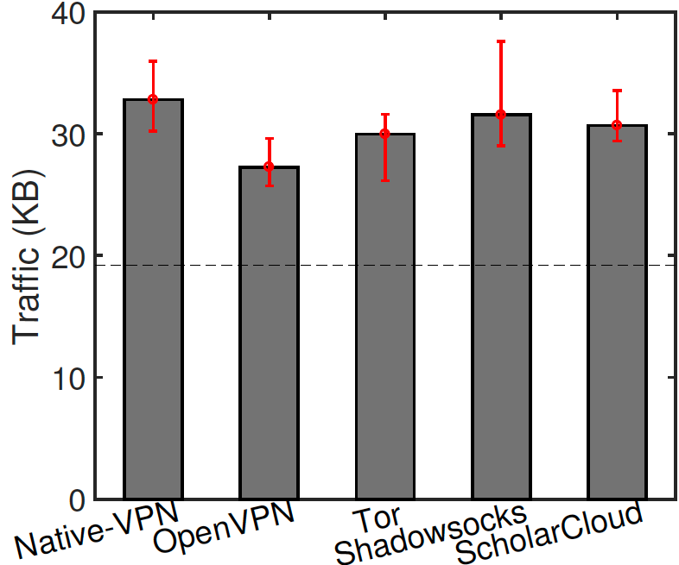
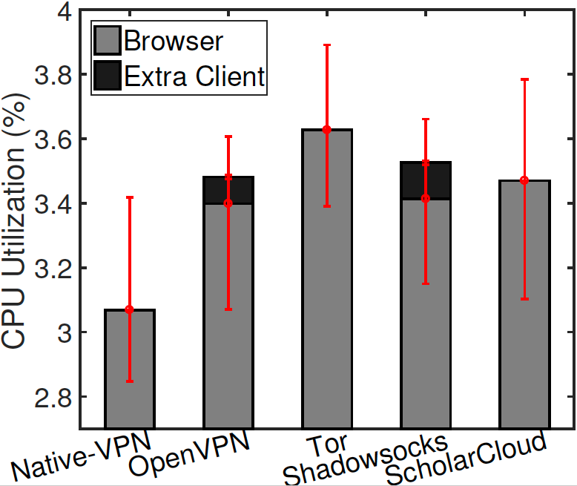
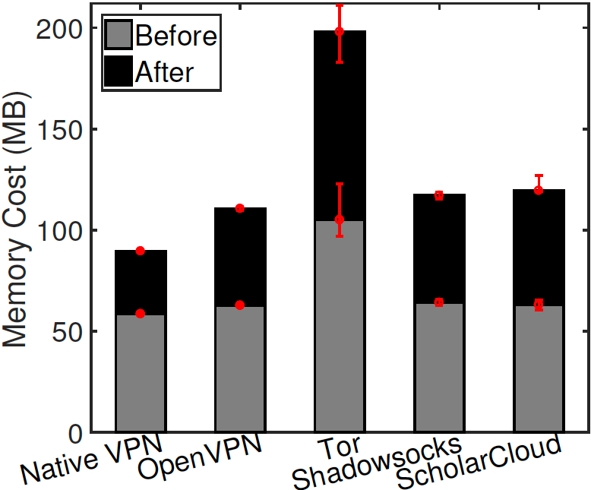
Client side overhead
Network Traffic
CPU
Memory
Differences are not remarkable, while ScholarCloud is no worse than the average.
Notes:
We also measured the client side overhead, including network traffic, CPU and memory

Slide 27
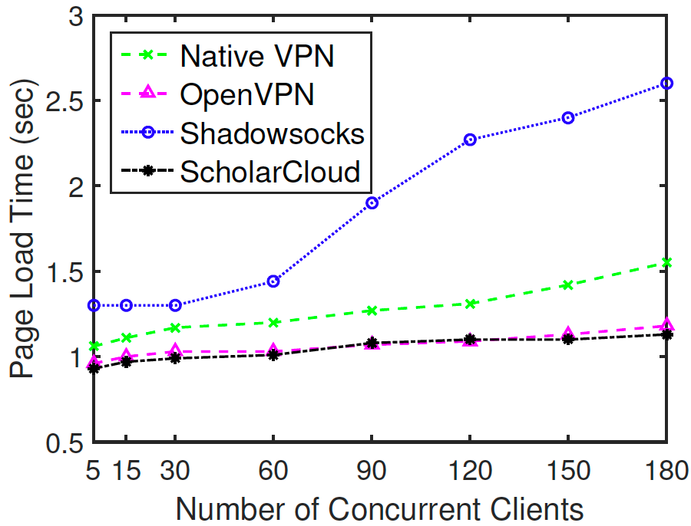
Scalability
Shadowsocks PLT sharply grows after 60
ScholarCloud acts well in large concurrency
Notes:
And at last, we also take a look at the scalability.
you can see from the pic that the page load time of SS grows sharply after the concurrent user number exceeds 60, that is because it is not designed for multi users. While our scholarcloud takes that into consideration so it atcs well in large concurrency
So that’s the all for the performance part

Slide 28
Summary
Legally accessing Google Scholar under extreme censorship
Design and deploy ScholarCloud to provide web proxy service to thousands of users, with high performance, usability, robustness against censorship, and low overhead
Measure and analyze five main circumvention system on network performance, client side overhead, robustness against censorship and scalability.
We provide a new perspective to Internet censorship in China. We hope that our experiences will help the community better understand China’s Internet censorship
ecosystem.
Notes:
here is the summary of our paper
provide a view for legally access …

Slide 29

The End
Thank you!
Notes:
So this is the end of our talk, thank you for your attention!

Slide 30
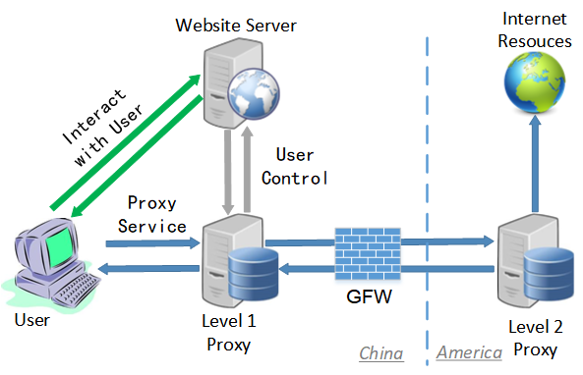
System Architecture
Portal website system
Split-proxy system
User control system

Slide 31
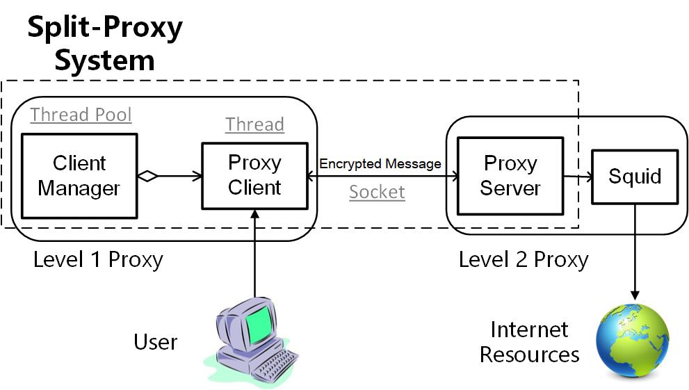
System Architecture

